Slide 1
Power BI dashboard for data analytics
By - Utkarsh Bhardwaj
1

Slide 2
INDEX
Objective
Power BI
Data
Data Import
Data Modelling
Data Engineering
Reporting (Power BI dashboard)
Snapshots of the Dashboard
Thank you
2

Slide 3
Objective
To derive insights like total orders, total orders by category, by subcategory, by individual product, by territory and the return rates associated with the products, the revenue target and the actual revenue generated at all levels of hierarchies.
3

Slide 4

Power BI
Power BI provides a set of software services, applications, and connections that work together to transform data sources into logical, visually engaging, and interactive insights. The data may be in the form of an Excel spreadsheet or a collection of hybrid data warehouses that are both cloud-based and on-premises.
4

Slide 5
Data
The data used for the project was in the form of csv files containing information of a bike manufacturing company about -
Customers
Sales
Returns
Products
Product Categories
Product Subcategories
5

Slide 6
Data Import
Most of the tables were imported using the simple import csv functionality of Power BI other than the sales data. Since the sales data was dynamic and a new file needs to be added for the sales of that particular year, the sales data was imported dynamically as a folder meaning that adding new files to the folder would automatically reflect new data in the Power BI report.
6

Slide 7
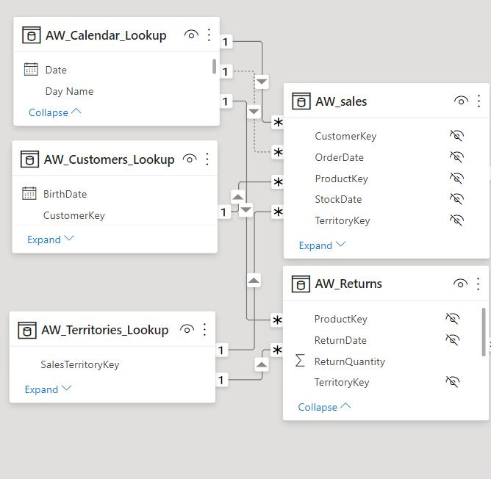
Data Modelling
Data modelling was done to establish relationships between the various tables present in the data set based on the identified primary and foreign keys in Power BI' s relationship view.
7

Slide 8
Data Engineering
Some aggregates and measures like total orders, total returns, return rates were engineered using DAX queries and aggregator functions available in Power BI.
8

Slide 9
Reporting
A report was made using the tools and visualization available in Power BI. There are drill through options available in the reports as well as clicking on fields changes the filter context. Some conditional formatting was also done to get more information out of the report without it becoming too overwhelming.
Following are a few snapshots -
9

Slide 10
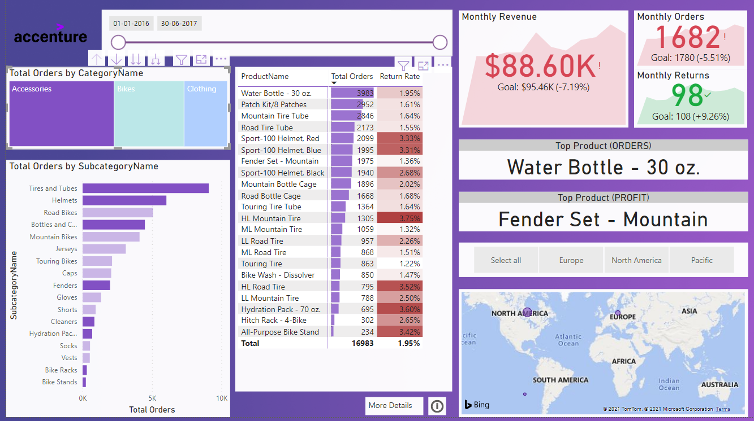
Report’s view after selecting accessories
10

Slide 11
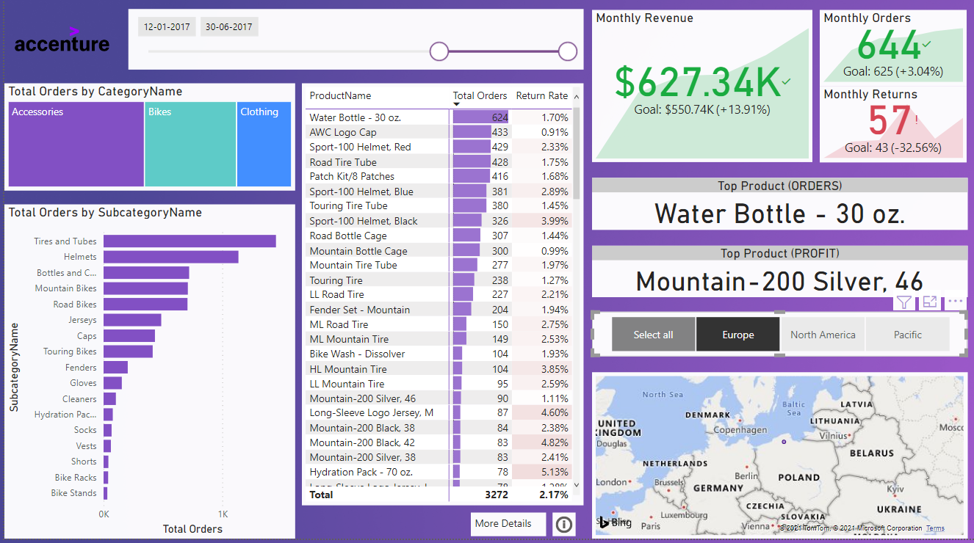
Report’s view with date slider set
11

Slide 12
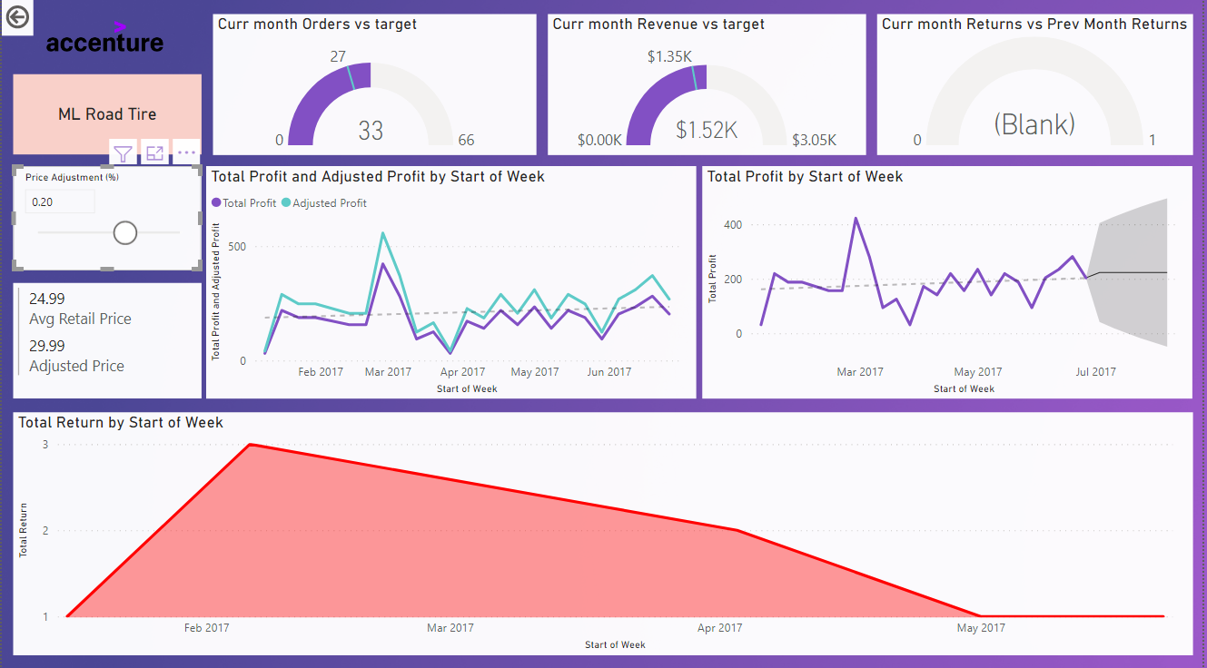
Product details page with a product selected
12

Slide 13
Thank you
13

